Slide 1

Predicting Flight Satisfaction for Airline Passengers
Isabella Oakes, Lina Nguyen, and Travis Lloyd

Slide 2
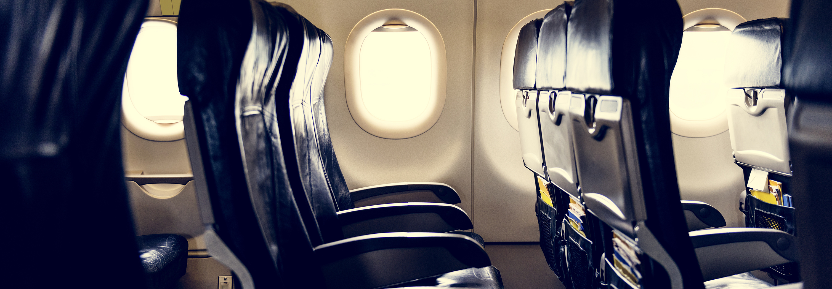
The Problem
Airline flights are long, cramped, and delays are common
Airline satisfaction is highly important for repeat business
Finding the most important features to customers can help business focus

Slide 3
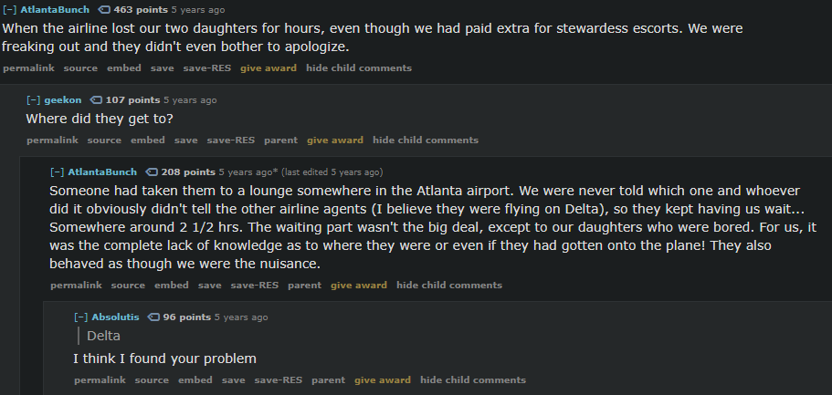
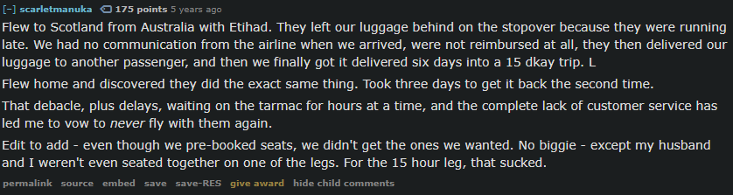
Lost children despite paying for stewardess escorts
No communication
Airline has a reputation
Lost luggage
No communication
Seats changed on a long flight without warning

Slide 4

Solutions
What did the survey focus on?
How can models help?

Slide 5
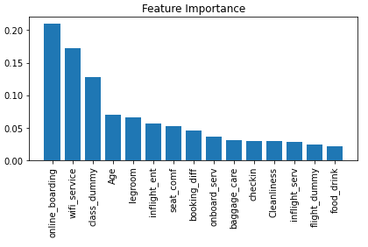
What the models found:
Top features airlines can address:
Online boarding quality
Wi-Fi Service
Leg room
Inflight Entertainment
Seat comfort
Easiest/cost effective solutions

Slide 6

Conclusion
Small changes can make big differences in flight satisfaction

